Slide 1
CENTERSTONE SCHOOL-BASED CLINICAL TRAINING SERIES
Avatar Basic Navigation
Admissions · Client Paperwork · Cancellations
School-Based Therapist Training
June 2026

Slide 2
Avatar Basic Navigation
Welcome to Today's Training
Before this training, you were asked to complete foundational Avatar videos on Relias. Today we build on that foundation — walking through the three core workflows every school-based therapist uses from day one: opening a new client chart, understanding the required paperwork, and managing cancellations correctly.
This training includes a live walkthrough of Avatar NX, hands-on UAT practice time, and a homework assignment you will complete before your next session.
Objectives — By the end of this training you will be able to:
01
Use the Admission Bundle correctly to open a new client episode in Avatar NX.
02
Identify each required client form, explain its purpose, and know when it must be updated.
Live walkthrough of Avatar NX
03
Complete all three types of cancellations accurately and understand why each distinction matters.
Hands-on practice in UAT
04
Navigate between Avatar: TN NX Live and Avatar: TN NX UAT (Testing) with confidence.
Homework before next session
05
Schedule an intake assessment and apply Eleos from the very first session to protect your time.

Slide 3
CENTERSTONE SCHOOL-BASED CLINICAL TRAINING SERIES
Why This Training Matters
Avatar is the engine that runs behind every clinical interaction. When it is used correctly from the very first contact, it protects clients, supports accurate reporting, and keeps the team running smoothly. When it is skipped or rushed, it creates downstream problems that are much harder to fix.
This training is not about memorizing a system. It is about understanding why each step exists — so that when something unexpected happens in the field, you know how to think through it.
The habits you build now — searching before creating, completing the bundle not just the form, cancelling correctly, documenting on time — are the habits that will protect you, your clients, and your program throughout your career here.
Accurate documentation is an act of client care. Treat it that way.

Slide 4
Before This Training
You were asked to complete the following on Relias prior to today.
Avatar NX Orientation Videos
Come Ready to Practice
Two Environments to Know
Watch the assigned Avatar NX foundational videos on Relias before attending this training. These cover the basic interface, navigation, and terminology we will build on today.
Today is hands-on. You will work in Avatar: TN NX UAT — the testing environment — so you can practice every step without affecting any live client records.
LIVE your real clinical workspace. UAT your practice and training sandbox. Never practice in Live. Never document real sessions in UAT.
UAT is your safety net. Use it often — especially when you are learning something new.

Slide 5
PART 1
ADMISSIONS
Use the Bundle. Not Just the Form.
The Admission Bundle is a collection of forms used when opening a new client episode in Avatar. It includes everything needed to open the episode correctly — not just the Admission form alone.
If you accidentally choose only the Admission form instead of the Admission Bundle, you will need to open each remaining form separately. This creates extra steps and increases the chance of missing something required.
The bundle exists for a reason. Trust the process.

Slide 6
Forms in the Admission Bundle
Admission
Opens the episode. Search by name and sex first — Avatar requires at least 3 matching pieces of information. Always verify against existing records to prevent duplicate charts. Check DOB or SSN.
PART 1 · ADMISSIONS
Parent/Guardian Info
Enter all guardians individually. The last one entered displays on the banner — enter dad first, then return and enter mom if she is the primary contact.
What the Bundle Includes
Emergency Contact Information
Parents are the primary emergency contact. An additional individual may also be listed — make sure a release is signed for them as well.
Complete every form in order. Do not skip steps.
Financial Investigation
SKIP — this is completed by support staff.
Referral Source and Military Detail
Admission
Do not skip this form. Required for timeliness reporting data. Dates matter — enter them accurately.
Parent/Guardian Info
Signature Forms (if client/guardian is present)
Emergency Contact
Notice of Privacy
Consent to Treatment
ROI Enterprise
Communication Request Auth.
Financial Investigation
If not present, skip and complete at intake using the Front Desk Bundle process.
Referral Source
Signature Forms
Dates matter in both the Admission form and Referral Source form. Do not wait until the intake date to open the chart — enter the client when you first speak with them.

Slide 7
Before You Create — Always Search First
Duplicate charts create real problems for clients. This step is not optional.
Existing Client
New Client
IF THE CLIENT IS ALREADY IN AVATAR
IF THE CLIENT IS NOT IN AVATAR AT ALL
—
Search by name and sex (minimum 3 data points — use SSN or DOB if needed).
—
Client does not appear in any search results — click New Client.
—
When prompted "Auto Assign Next ID Number?" — always choose YES.
—
Avatar returns clients with similar names or birthdates — check carefully.
UAT Exception: If you are working in UAT for training purposes and have been assigned a specific number to use, use that number instead of auto-assigning.
—
If your client appears on the list, click that client.
OPEN EPISODE EXISTS
—
Click the episode line without a Discharge Date and choose EDIT — not ADD.
—
Complete all bundle forms in order before closing the chart.
NO OPEN EPISODE
—
Click ADD to open a new episode on the existing client record.
Remember: even in UAT, always practice the search step before creating a new client. Build the habit now.
One duplicate chart can follow a client for years. The search step takes 30 seconds. Do it every time.

Slide 8
Type of Admission — Choosing Correctly
The type of admission you select affects reporting data and the client record. Choose carefully.
PART 1 · ADMISSIONS
TYPE 01
TYPE 02
TYPE 03
First Admission
Re-Admission
Transfer
Use for clients who have never received services at Centerstone before. This opens a brand new episode and client history.
Use for clients who have received Centerstone services before and have a prior discharged episode. Do not open a new chart — connect to the existing client record.
Use when a client is transferring from another Centerstone program or clinician within the same system. Consult your team lead if you are unsure which type applies.
1
2
3
When in doubt, ask before you submit. Selecting the wrong type is fixable — but easier to get right the first time.

Slide 9
PART 2 · CLIENT PAPERWORK
Admissions
Client Paperwork
Cancellations
Every Form Has a Purpose. Every Signature Matters.
The forms in this section are required for every client who begins services at Centerstone. Some are completed at first contact, some at intake, and some require periodic updates throughout the episode of care.
In this section we will review each required form by name, discuss its purpose and what it means for the client, and identify how frequently it must be updated. Your team lead will confirm update schedules for your program.
✦ Knowing how to explain each form to a parent or guardian in plain language is a clinical skill. Practice it. ✦

Slide 10
Paperwork required for treatment and update frequency
PART 2 · PAPERWORK
Required Client Forms
Consent to Treatment
Client and/or guardian acknowledges the right to refuse or adjust services, understands the cancellation policy, and consents to services including telehealth. For clients under 16, a parent or legal guardian must sign.
Consent to Treatment
Notice of Privacy
Communication Consent
Client Rights (signature form)
Update frequency: Signed during intake or before the intake, valid through duration of episode (update if client turns 16.)
Notice of Privacy Practices
Informs clients of how their health, mental health, and substance use information may be used and disclosed. Covers client rights including the right to review records, request corrections, and file complaints. Required by HIPAA.
Update frequency: Signed during or before the intake, valid trough duration of episode (update if client turns 16.)
Communication Consent
Client selects how they agree to be contacted — text, email, phone, mail — and for what purposes. Required for clients receiving telehealth services, who must consent to both text and email contact.
Update frequency: requires update when a client or parent/guardians contact information is updated.
Client Rights
Documents that the client has received orientation to services, a copy of their rights and responsibilities, and the TennCare Kids Brochure if applicable. Signed form is submitted to medical records for scanning.
Update frequency: this form is required annually
When obtaining signatures, always print the name of the person signing — especially for guardians signing on behalf of a minor.

Slide 11
PART 2 · PAPERWORK
Paperwork continued…
Required Client Forms
Release of Information for Treatment, Payment, and Health Care Operations
Broad authorization allowing Centerstone to release client information to treating providers, health plans, and third-party payers for the purposes of treatment, payment, and operations. Expires 180 days from discharge.
TPO
Release of Information
Student Preferred Name – Parent consent form
Not a physical form, but an Avatar
form and reminder to update custody.
Update frequency: this form is valid for the duration of treatment (requires update if a client turns 16)
Release of Information
Specific, client-directed ROI for sharing information with named parties — such as the school system, primary care provider, emergency contact, or another agency. Must identify what is released, to whom, for what purpose, and the expiration date.
Update frequency: this form is required annually. For school-based clients, the school release should be for the school system (not the specific school; do not use abbreviation.)
When updating the PCP release, also make sure to update the PCP communication form and that it is linked to the new release. Do not update the PCP communication form with
Updating the release first.
Parent/Guardian Info and Emergency Contact
Verified and updated in Avatar when information changes. If more than one guardian exists, each must be entered individually. Emergency contacts beyond parents require a signed release. Make sure to obtain custody paperwork if anyone other than bio mother is requesting services.
Update frequency: update custody information as soon as you learn of the change.
Student Preferred Name — Parent Consent Form
Required by Tennessee law (TCA § 49-6-5102) before any Centerstone employee uses a name or pronoun for a student that differs from their legal name or gender assigned at birth. Applies only to Centerstone counseling sessions. Must be signed by parent or legal guardian.
Update frequency: this form is specific to minors seen in a school setting. This should not be completed for all clients.
Forms 5–8 of 8 Required Documentation
School-based ROIs should always include releases for the school system and the primary care provider. Your team lead can provide samples.

Slide 12
“
More Than a Signature
Every form a parent signs is an opportunity to build trust, communicate clearly, and set the tone for the therapeutic relationship. Families who feel informed and respected engage better and stay longer.
Your homework before the next session is to practice explaining each form in plain, warm language, not legal language.
How would you explain the Notice of Privacy to a nervous parent in a school hallway?
How would you explain the ROI for the school system to a guardian who is not sure they want the school involved?
The paperwork is not administrative noise. It is your first clinical conversation.
A well-informed family is a more engaged family. Take the time to explain, not just obtain.

Slide 13
As You Build Your Schedule — A Few Things Worth Remembering
Scheduling well is an act of self-care as much as it is an act of clinical planning.
Build your week before it starts
Use Eleos from the first session
Protect the margins in your day
Entering the week with a full schedule reduces cognitive load and gives your team lead the chance to help you problem-solve early. A plan gives you control — even when the day changes.
Start Eleos before your first clinical question. Let it capture the session. Use the last few minutes with your client to map outputs to your note. Walk out of school with your documentation done.
A schedule without breathing room is a schedule that breaks under pressure. Build in buffer. Protect your lunch. The boundaries you set with your calendar are the same ones you will model for your clients.
Eleos + intentional scheduling = more time for what brought you to this work in the first place.

Slide 14
PART 3 · CANCELLATIONS
Three Types. Three Reasons. All of Them Matter.
There are three distinct cancellation types in Avatar for individual and family sessions. Using the right one is not just procedural — it affects clinical service history, reporting data, and the client record.
No Show / Late Cancellation
Cancelled by Client
Cancelled by Therapist
We will walk through each one step by step. You will practice all three in UAT today.
Group appointments have a completely separate cancellation process — covered in a future training.

Slide 15
Cancellations — Step by Step
Right-click the appointment → Status Update to begin any cancellation.
NO SHOW / LATE CANCELLATION
CANCELLED BY CLIENT & CANCELLED BY THERAPIST
—
Use when a client cancels less than one full business day before the appointment, or does not show.
Cancelled by Client
—
Used when client cancels more than 24 hours / 1 business day in advance.
—
Example: client calls late Friday to cancel a Monday morning appointment.
→
Right-click → Status Update → change to Cancelled
—
Right-click → Status Update → change Scheduled to Did Not Show/Late Cancellation (left side).
→
Select 90001 Cancelled by Client INDIVIDUAL
90001 Cancelled by Client INDIVIDUAL
—
Right side: select 90000 No Show/Late Cancellation INDIVIDUAL.
→
Leave Missed Visit checked. Add a note with reason and your initials.
90000 No Show/Late Cancellation INDIVIDUAL
—
Left and right sides must match. Missed Visit (Yes) must remain checked.
Cancelled by Therapist
—
Add a Missed Visit Note and your initials.
—
Used when you need to cancel a scheduled appointment.
Always say YES when asked to post the missed visit — this records it in Clinical Service History.
→
Same process → select the Cancelled by Therapist code.
—
The appointment remains on the calendar with a ✕ red X. It cannot be found as an available slot by support staff.
→
Add a clear note. Rebook the client as soon as possible.
✕ red X
—
For late cancellations: document the reason the client gave. This helps identify patterns over time.
—
Before cancelling a no-show: attempt contact and wait 15 minutes. Use that time for notes.
"Individual" in the cancellation code refers to the appointment type — not the therapy modality. Individual and family sessions both use the INDIVIDUAL codes.

Slide 16
Once the Chart Is Open — What Comes Next
PUTTING IT TOGETHER
Complete the bundle before closing
All forms in the Admission Bundle should be completed or intentionally deferred before you close out. Deferred forms should be flagged for completion at intake.
From Chart Open to First Session
Schedule the intake assessment
Schedule the intake in Avatar as soon as the chart is open. Do not wait. The sooner it is on the calendar, the sooner the client begins receiving care.
The steps that connect admissions, paperwork, and your clinical workflow.
Use recurring appointments when possible
From the very first scheduled session, build for consistency. Recurring appointments reduce scheduling time, help clients build routine, and increase follow-through.
Start Eleos at the intake
Your intake is a clinical session. Start Eleos before your first clinical question. It captures the session, reduces your documentation burden, and lets you be fully present with the client and family.
Confirm the next appointment before the client leaves
Whether it is the intake or any subsequent session — confirm the next appointment before they walk out. This one habit prevents more gaps than almost anything else.
A complete chart, a scheduled intake, and Eleos running — that is how you start strong.

Slide 17
Homework — Practice Makes Permanent
Complete all three steps in Avatar: TN NX UAT before your next training session.
01
02
03
STEP 1
STEP 2
STEP 3
Open a New Chart
Practice the Paperwork
Practice Cancellations
Use the attached practice referral form to create a new client chart in UAT using the Admission Bundle. Complete every form in the correct order. Practice the search step first — even in UAT.
Go through each form in the intake paperwork process in UAT. As you complete each one, practice how you would explain it to a parent or guardian in plain language. Consider: what questions might they ask? How would you answer?
Schedule three appointments for your practice client — one today, one two days from now, one after that. Practice all three cancellation types: No Show/Late Cancellation, Cancelled by Client, and Cancelled by Therapist.
Come to the next session ready to share one thing that surprised you and one question you still have. Both are equally valuable.

Slide 18
KEY TAKEAWAYS
Avatar Basic Navigation — Key Takeaways
What to carry out of this room today.
1
Use the bundle — always.
2
Search before you create.
The Admission Bundle exists for a reason. Opening just the Admission form skips required forms and creates more work later.
Duplicate charts follow clients for years. The search step takes 30 seconds. Do it every single time.
3
Every form has a purpose.
4
Cancel correctly — every time.
Each signature is a clinical conversation. Know what you are asking families to sign — and why it matters for their care.
The right cancellation code protects the client record, the reporting data, and your documentation. When in doubt, ask.
5
Start Eleos at the intake.
6
Protect your schedule — and yourself.
Your documentation habit starts with your first session. Eleos running from the first clinical question means you walk out with your note done.
Build your week before it starts. Protect the margins. A sustainable schedule is not a luxury — it is how you stay in this work long-term.
Centerstone School-Based Clinical Training Series · Avatar Basic Navigation

Slide 19
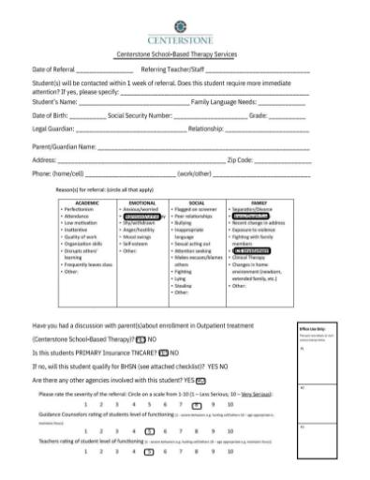
Homework
Put it all together — practice the full new-client intake workflow in UAT.
YOUR ASSIGNMENT
PRACTICE REFERRAL FORM
1
Use the attached practice referral form to create a new client chart / admission bundle in UAT.
2
Go through and practice completing each form in the front desk bundle, and consider how to explain each form to a parent or guardian.
3
Then practice scheduling the intake assessment.
Centerstone School-Based Clinical Training Series · Avatar Basic Navigation

Slide 20
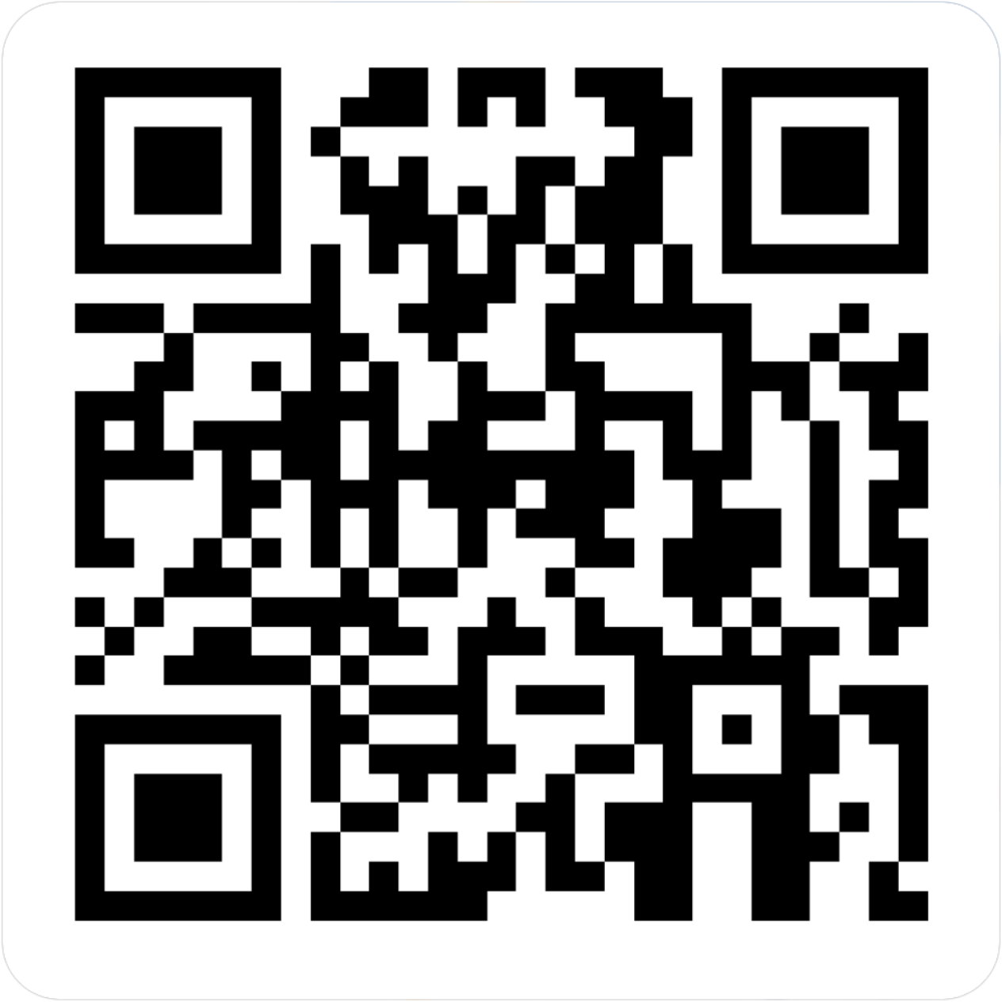
CENTERSTONE SCHOOL-BASED CLINICAL TRAINING SERIES
Avatar Basic Navigation
Completion of this survey is required for attendance verification for today’s training.
https://forms.office.com/r/EXVCQtPbti

